Slide 1
OLIST STORE ANALYSIS DASHBAORD
FY 2016-2018

Slide 2

MEET OUR TEAM MEMBERS
01
02
PRIYANKA BABAR
SHALU P VINAYAN
GROUP 5

Slide 3
AGENDA
1.
About Us
2.
Overview
3.
KPI’s
4.
Analysis of additional KPI’s
5.
Insights
6.
Recommendation
7.
Summary
8.
Conclusion

Slide 4



ABOUT US
Olist is a Brazilian e-commerce platform that provides solutions for small and medium-sized business to sell their products online. It was founded in 2015 by Tiago Dalvi and has since grown into one of the largest online market place in Brazil.
The company enables sellers to manage listings , inventory, orders, shipments and messages at a certain price per month.

Slide 5
OVERVIEW
The Olist Store Analysis project to analyze customer purchasing pattern and payment statistics on an E-commerce platform, Olist .This project covers several key weekend sales, payment statistics, delivery time, and customer behavior. The analysis is based on nine CSV files, which are cleaned and manipulated to extract valuable insights.

Slide 6
DATA EXPLORATION & CLEANING:
The analysis is based on 9 CSV files ,which are cleaned and manipulated to extract valuable insights. Identify missing and duplicate values in each dataset and treat them accordingly. Also treat all data quality issues associated with the dataset.
olist_customers_dataset.
olist_geolocation_dataset.
olist_order_items_dataset.
olist_order_payments_dataset.
olist_order_reviews_dataset.
olist_orders_dataset.
olist_products_dataset.
olist_sellers_dataset.
product_category_name_translation.

Slide 7
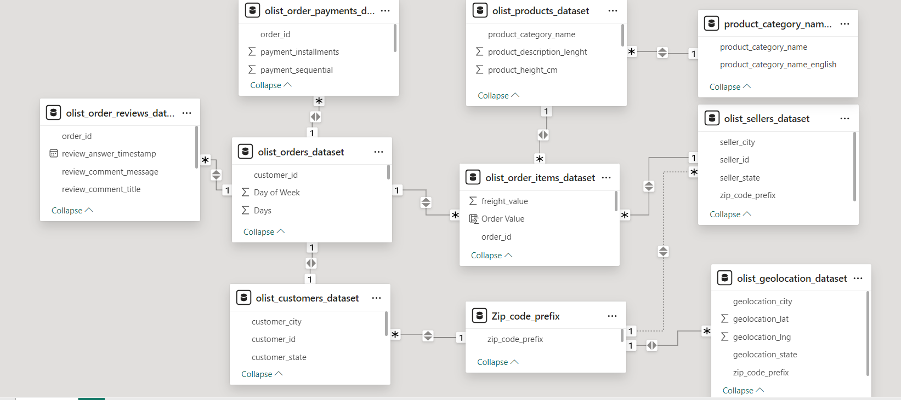
DATA MODELLING :
Build relationships of all datasets by creating bridge table in power query.

Slide 8
DATA MERGING :
For Extracting Different kpi's we need to merge the 2 or 3 datasets with the help of power query
DATA VISUALIZATION :
Create appropriate visualizations to identify the most ordered products by payment statistics and purchasing patterns.
MARKET ANALYSIS :
Identify combinations of average delivery days for product category and calculate shipping days and visualise them as required.This can be done by creating a custom column in power query of powerbi.

Slide 9
KPI’S
Weekdays & weekend payment statistics
Payment type with review score 5
Average number of delivery days taken for pet shop
Average price and payment value of sao paulo city
Average shipping days vs review score

Slide 10
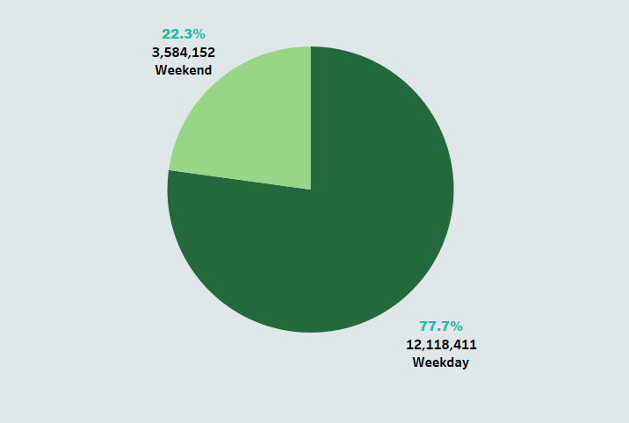
Weekdays vs Weekend payment value
KPI -1
The analysis of payment statistics based on weekday vs weekend provides an understanding of the buying behavior of customers. From this KPI, can understand weekdays has more sales than weekend .The analysis of this KPI can help Olist to improve their weekend sales and plan promotions accordingly.
77%
22%
Weekday
Weekend

Slide 11
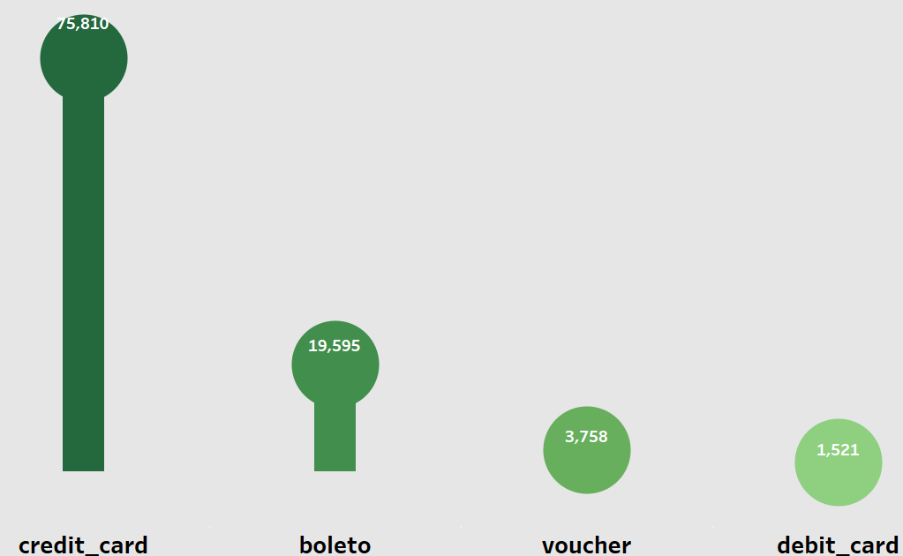
Payment type with review score 5 & credit card
KPI -2
This KPI analyses the number of orders with a review score of 5 and payment types as credit card. This helps in understanding customer satisfaction levels and payment preferences. Olist can use this information to identify satisfied customers and encourages them to make repeat purchases.
credit_card
boleto
voucher
debit_card

Slide 12
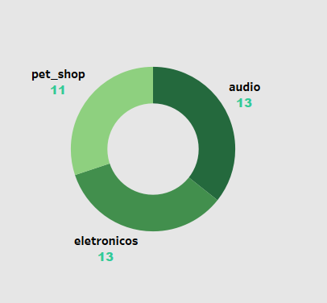
Average no:of delivery days taken for pet shop
KPI -3
This KPI analyses the average number of days taken for order_delivered_customer_date for pet_shop. It helps Olist in identifying areas where they can improve their delivery time and maintain customer satisfaction.
13
13
11
audio
electronics
pet_shop

Slide 13
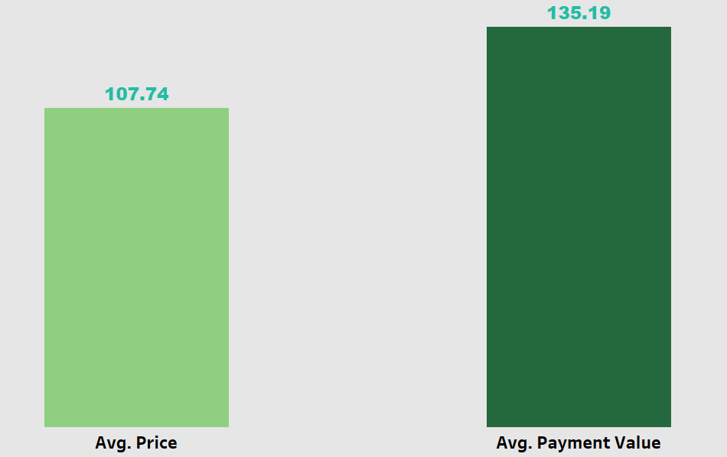
Average price & payment value of sao paulo city
KPI -4
The analysis of average price and payment values from customers of Sao Paulo city helps in understanding the spending patterns of customers in this region. It also helps Olist in identifying high-value customers and creating targeted-marketing campaigns.
Avg.Payment Value
Avg.Price

Slide 14
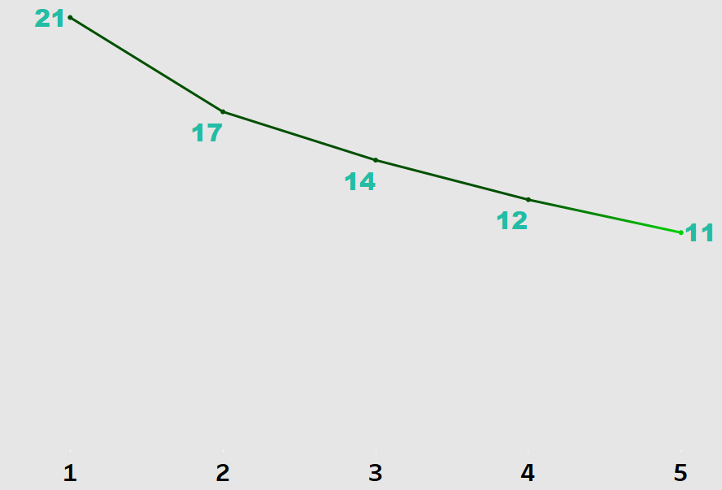
Average shipping days vs review score
KPI -5
This KPI analyzes the relationship between shipping days and review scores. It helps in understanding the impact of delivery time on customer satisfaction levels. Olist can use this information to optimize their logistics and improve their delivery time.

Slide 15
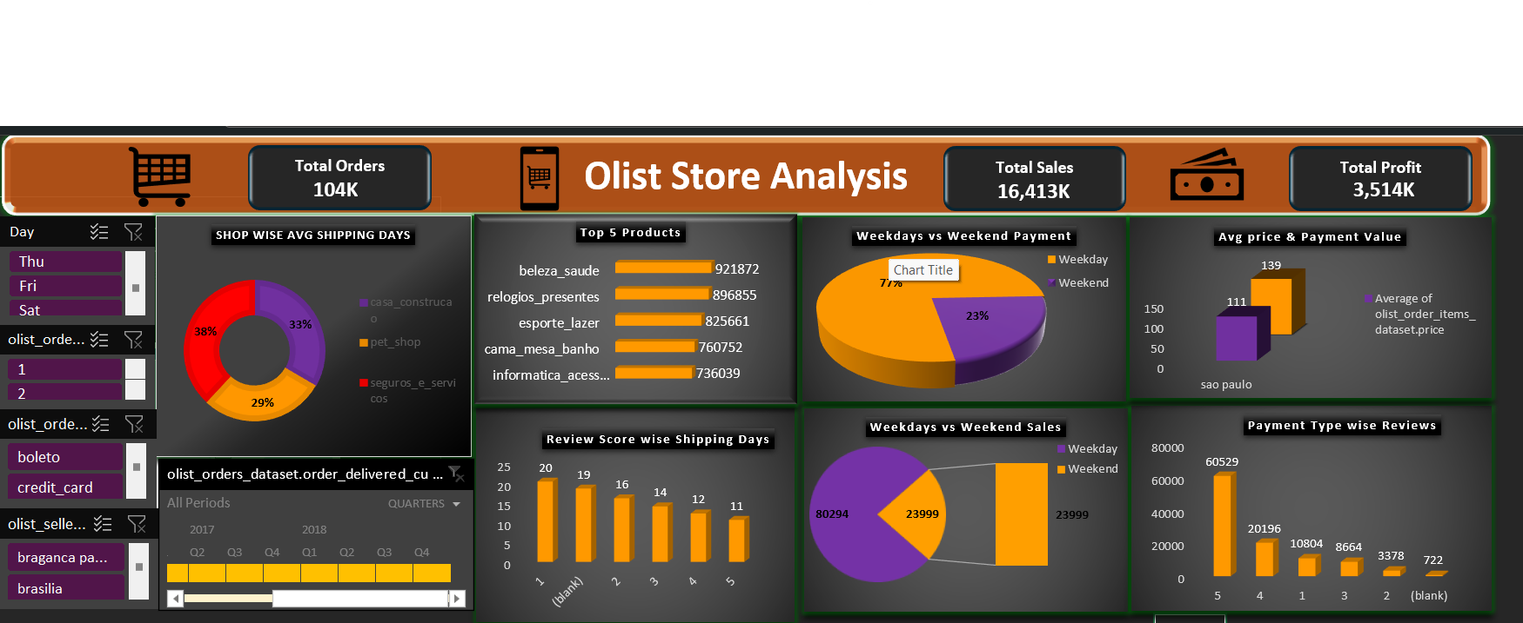
Olist Excel Dashboard

Slide 16
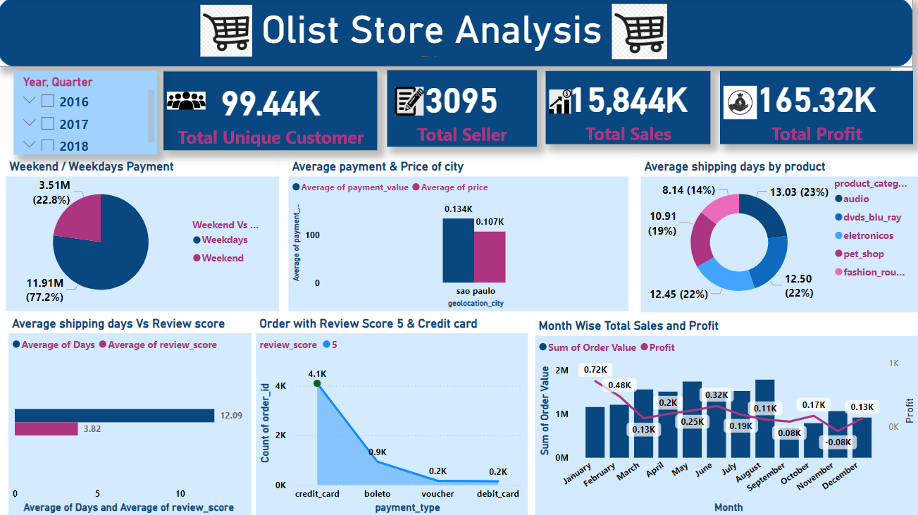
Olist Power bi Dashboard

Slide 17
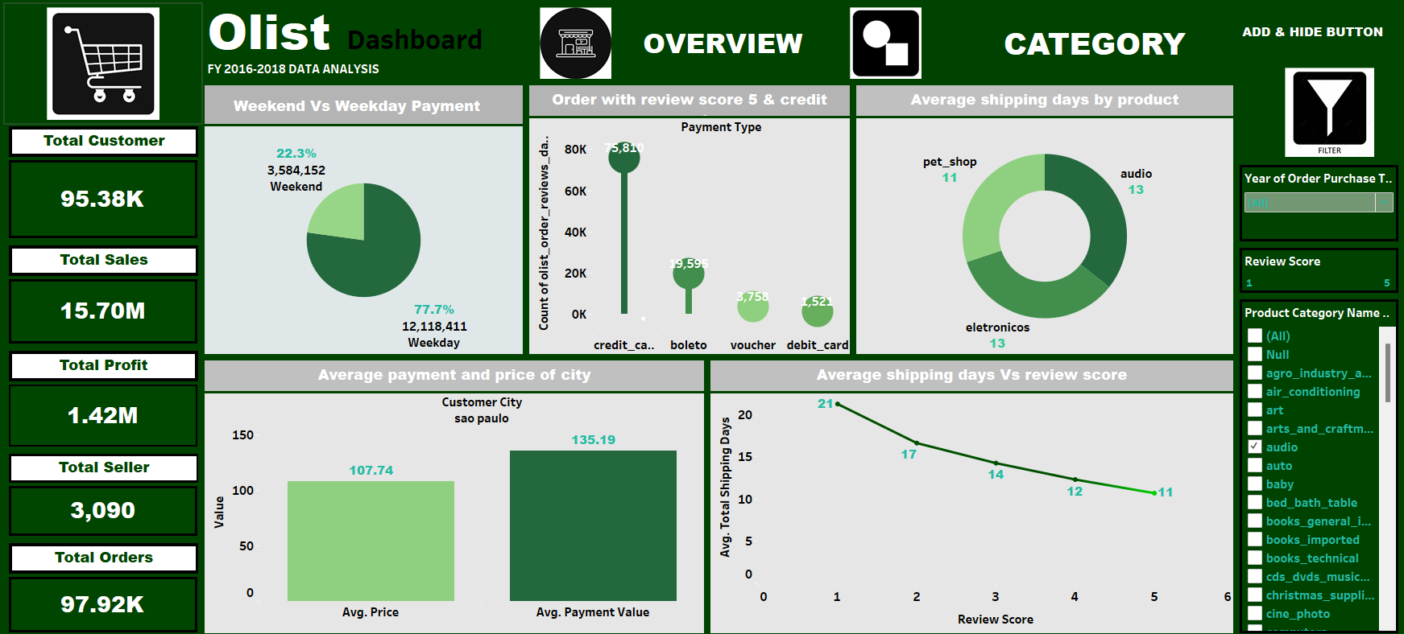
Olist Tableau Dashboard

Slide 18
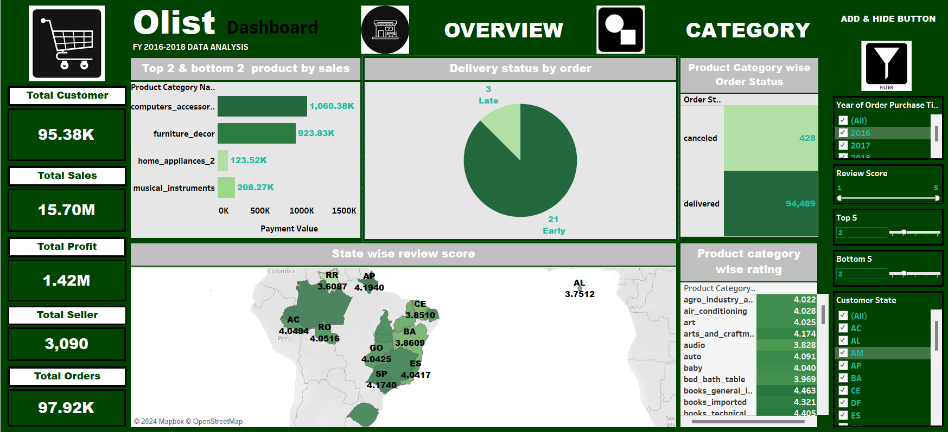
Olist Tableau Dashboard

Slide 19
ANALYSIS OF ADDITIONAL KPI’S

Slide 20
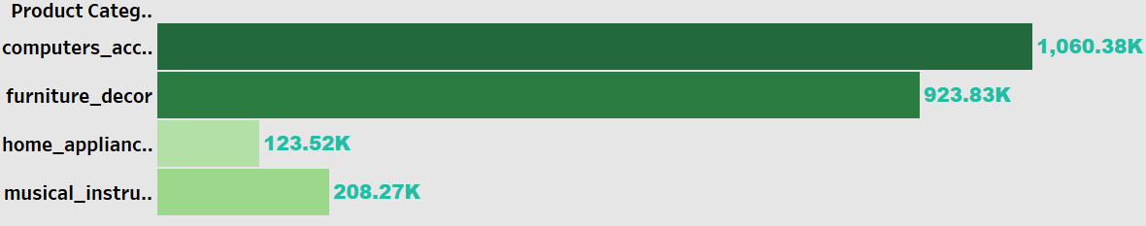
Top & bottom product by sales
KPI -6
The analysis of top and bottom product by sales provides an understanding of the buying behavior of customers. The analysis of this KPI can help Olist to improve their performance of sales in various categories and plan promotions accordingly.
Top
Bottom

Slide 21
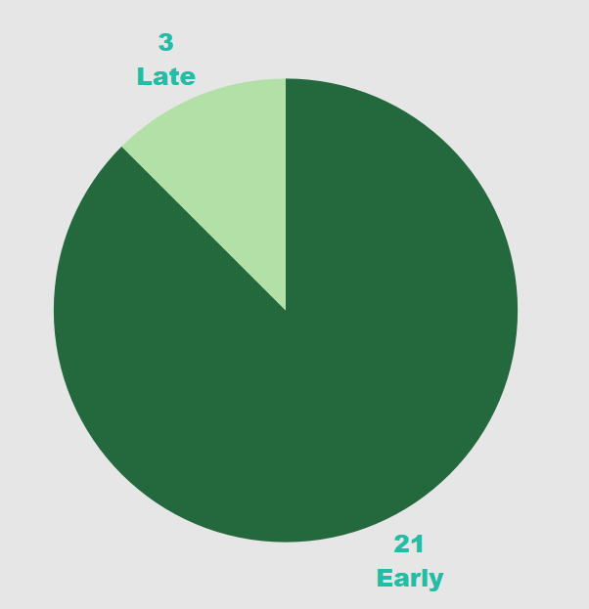
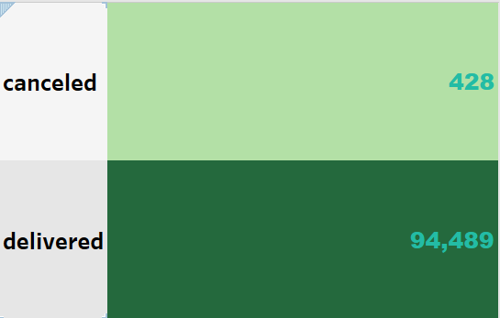
Delivery status by order
KPI -7
KPI -8
Product category wise order status
canceled
Late
delivered
Early
This KPI analyze the delivery status by order and order status by category . It helps to increase the satisfactions in customer and build trust in them.

Slide 22
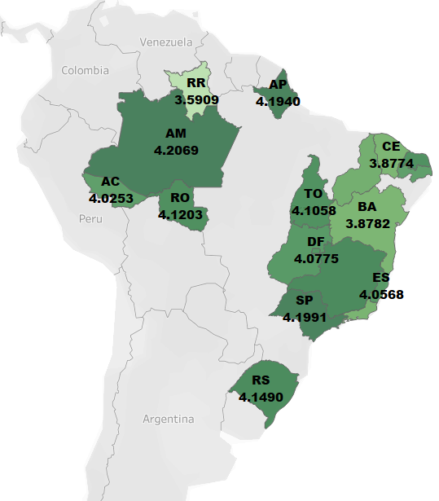
State wise review score
KPI -9
This KPI’s helps to understand the review rating in state wise and analyze the variance in customer behavior in different state. It helps Olist to improve the rating according to the trend in customer behavior.

Slide 23
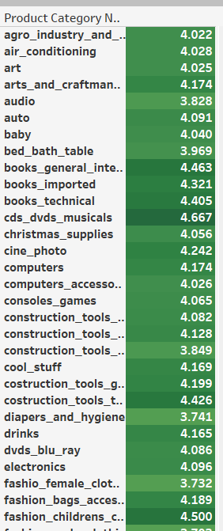
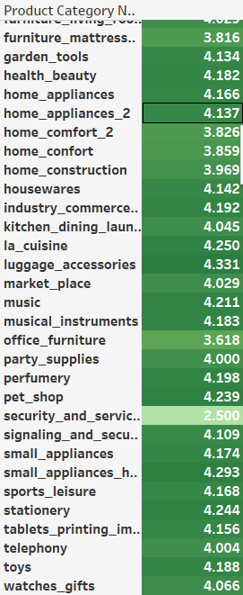
Product category wise rating
KPI -10
This KPI analyze the satisfaction level of customer in product wise and helps to understand about the product quality. Only for security and service have the low rate at 2.5.

Slide 24
INSIGHTS
According to the data, Olist E-commerce has about 99,440 orders. With about 89,940 orders being delivered, the company has a 90% delivery success rate.
Their average product rating is 4.09 stars, with product categories going as high as 4.67 stars and as low as 2.5 stars.
Star reviews are on third place in the review score distribution ranking which likely indicates that there could be problems with product quality in some product categories.
Delivery performance could also influence review scores and success rate could certainly be improved.
Insights from this analysis can help in making business decisions, such as focusing on products that customers are interested in, improving product and service quality, and optimizing marketing in provinces with high total sales.
In addition, this analysis also provides an overview of customer consumption trends and patterns that can be used to direct further business strategies.

Slide 25
RECOMMENDATION
Regularly monitor and analyze customer reviews to gain insights in product quality and identify areas for improvement.
Dashboards can be used to identify patterns in customer reviews. This will provide a data-driven approach to enhance customer experience.
Investigate delivery delays and undelivered orders.
Analyzing geographic locations could bring insights about certain challenges with demographics,accessibility,and possible route optimization.
Tracking fleet performance with the use of telematics can help identify issues before they become a problem.

Slide 26
RECOMMENDATION
Providing a proper shipment tracking system aids in having clear and concise communication between customers, sellers and couriers.
Regular updates can set proper expectations among customers and specific delivery instructions of customers can be properly accommodated .
By establishing trust and communication, both parties can work together to resolve any issues that may arise.

Slide 27
SUMMARY
Overall, regular monitoring of customer reviews, real time tracking of fleet performance, together with proper shipment tracking and communication system can improve Olist’s delivery and supply chain performance and ensure customers are highly satisfied with the service.

Slide 28
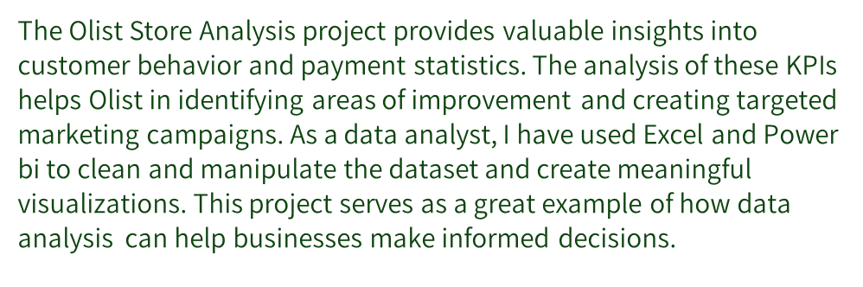
CONCLUSION

Slide 29
THANK YOU

